Slide 1

Peter Wilson: Writ of Habeas Corpus – Officer Michael Yore
Nanette M. Barto, CQDE
Eye for the Obvious

Slide 2
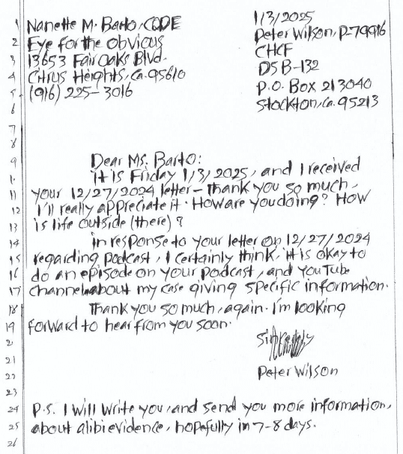
On 3-31-1996 Peter Wilson was arrested, charged, and subsequently convicted of MURDER.
His story is much like that of many inmates, he is innocent.
On 1/3/2025, Mr. Wilson has given me permission to discuss his case on a public podcast so that I may share the evidence with the court of public opinion while waiting on a Writ of Habeas Corpus from the Santa Clara County Superior Court to vacate his conviction.
Mr. Wilson’s contentions are that: he was illegally searched; evidence had been stolen/planted by Officer M. Yore of Palo Alto Police Department which was used to convict him; alibi evidence and exculpatory evidence ignored or withheld from the defense; medical reports and experts for the DA lied during testimony; and the DA presented a false case while knowing there was another suspect that was never investigated, “William Coleman,” who fled the country.

Slide 3
Facts of Case: Murder of Hak Joo Kim
Saturday March 30, 1996 or Sunday March 31, 1996 @ 1160 Fulton Avenue, Palo Alto, CA
59 years old, single woman of Asian decent
Divorced for 20 years and not known to be dating anyone by friends and family
Last spoken to between 12:44-12:48pm by her niece’s husband
Niece attempted 2 phones call before 1:12pm and got a busy signal – Phone Records support
1:12pm her niece tries to call back and only gets Kim’s voicemail
Found bludgeoned to death in her basement partially nude with a 4x12 = 3.4x11 wooden beam found on top of her shoulders
Robe on the ground next to her, she was wearing pants and underwear, no shirt was present, and her right shoe was found next to the body
A leaf from the basement floor is found stuck to Kim’s buttocks even though her pants and underwear were on which would indicate that her pants had been removed and put back on in the basement during the act
Blood and the murder weapon found in kitchen sink was a lie – no murder weapon found
Kim’s car was gone and an unknown car was in her driveway with a car cover over it at 2:02 pm when Mr. Wilson arrive and left in cab. Unknown car was gone and Kim’s BMW was in driveway at 3:45am when Mr. Wilson returned.
Rape kit was performed – seminal fluid found on thighs and in vaginal canal and an intact motile sperm was found at 9:30am April 1, 1996 – This was never tested for DNA

Slide 4
District Attorney Linda Condron Argues:
DA claims murder occurred between 12:48pm and 1:58pm and that Mr. Wilson had taken the phone of the hook.
Suspect sat victim down before murdering her and made her write and sign 3 rental receipts for him in the 1 hour and 10 mins in time he has to murder her
Suspect bludgeoned victim in the basement – Multiple contusions and lacerations to head and face
Suspect lays a 4x12 beam onto the body
Suspect had time to clean up and take Kim’s shirt because it had blood on it or she wasn’t wearing one
DA argues that Ms. Kim had not been raped – it was consensual sex with an unknown lover at an earlier time up to 3 days prior
Medical examiner, Parviz Pakdaman, testifies that no visual sign of torn or damaged tissue to the vaginal region indicated no rape occurred, but testified in other cases more recently that just because there isn’t visible damage doesn’t mean they weren’t raped
Crime Lab Technician, Nancy Marte, found one intact sperm, but testifies that sperm can maintain motility for up to 72 hours so it is possible that the victim had consensual sex as early as three days before being killed – this was never tested for DNA?!?
Lab Technologist Milt Smith testifies he drew 2 vials of blood
Two officers testify that there was only one vial of blood booked from Peter Wilson
Pages 9 Roger’s Restaurant Alibi, and 126 CalTrans Receipt Alibi were removed from police file and not provided to the defense during both trials.

Slide 5
Det. Michael Yore contact’s coroner at 6:56pm on 3-31-96, and tells him to show up in 45-55 mins. He has to wait an additional 20-25 mins. to go down to the basement because the forensic team was not yet finished when he arrived.
The coroner’s statement that the body was in full rigor mortis at approximately 8:30pm based on his testimony. And, rigor mortis was gone by 9:30am April 1, 1996.
Medical Examiner Parviz Pakdaman testifies rigor mortis or stiffness is development of rigidity in the decedent’s muscle which starts usually after death. We expect to have full rigidity within the first 8-12 hours. Rigidity depends on a number of factors. One would be the state of health of the decedent prior to death, the weight, whether he or she was thin or obese. The exposure to ambient temperature, to the heat would expedite the process, the cold would delay the development and its disappearance. Ms. Kim’s body was in a cool basement then refrigerated.
The overall timeline of rigor mortis under ordinary conditions is as follows:
8-12 hours: full rigidty
12 hours: stays in full rigor
12 hours: rigidity disappears within the next 12 hours
Total 36 hours depending on temperature

Slide 6
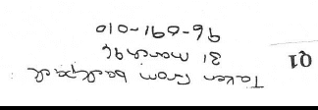
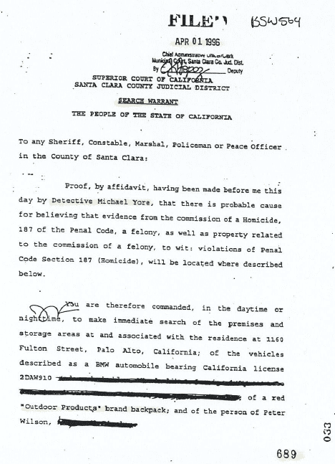
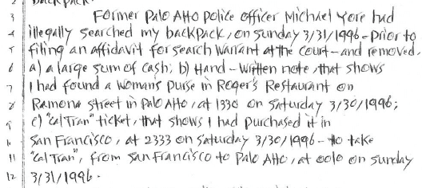
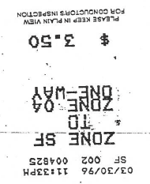
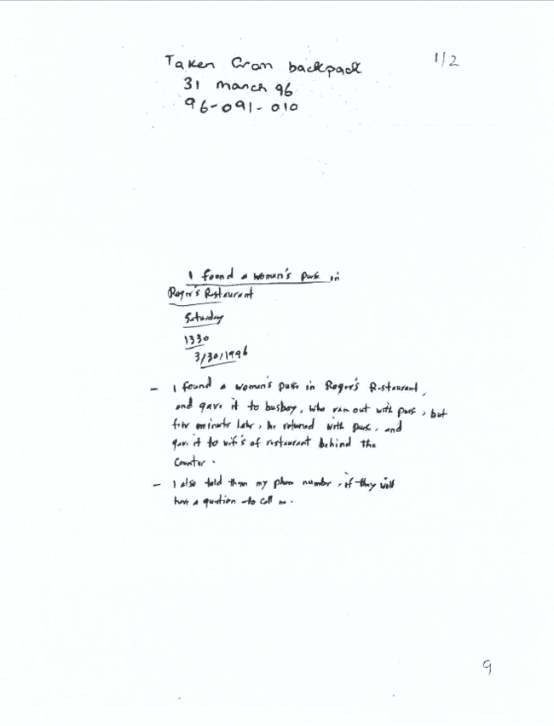
Illegal search and seizure
Warrant filed April 01, 1996
Evidence seized 31 March 96
Withheld from evidence and discovery to the defense team

Slide 7
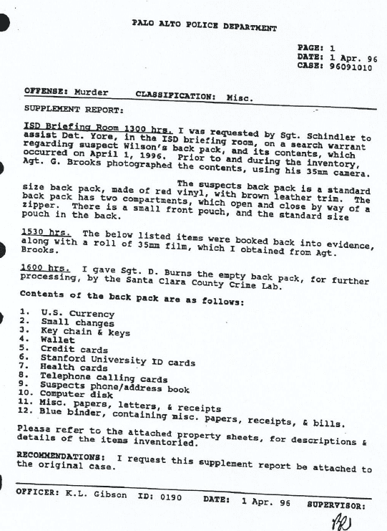
Report from Evidence collected shows 4-1-1996
Officer K.L. Gibson states that they assisted Det. Yore in the execution of the search warrant executed on 4-1-96 in a report dated 4-1-96 @ 3:30pm – 4:00pm

Slide 8
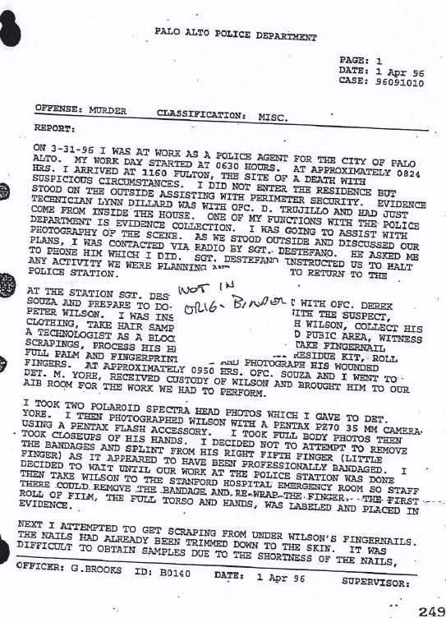
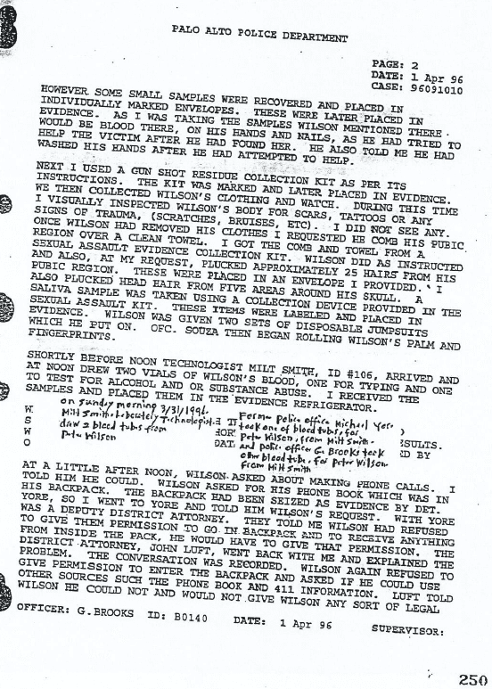
Officer G. Brooks puts in his report that Mr. Wilson claimed Kim’s blood would be under
his fingernails because he tried to help Kim.
Mr. Wilson remembers saying he would have his own blood under his nails because of hand injury.
What happened to those scrapings and did they match the victim’s blood type?
What happened to his bandage that was removed at the hospital and did it test positive for the victim’s blood?
Report from Evidence collected shows 4-1-1996 from Officer G. Brooks

Slide 9
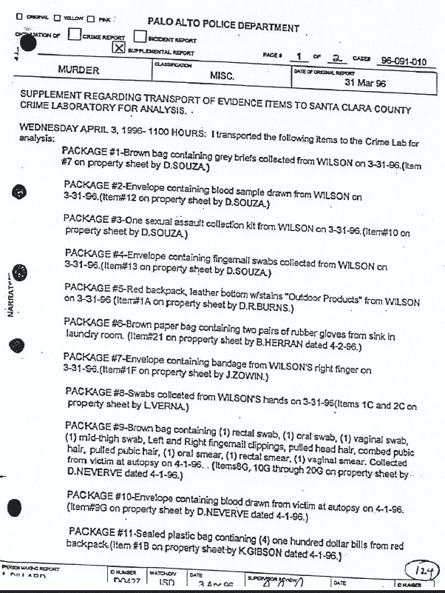
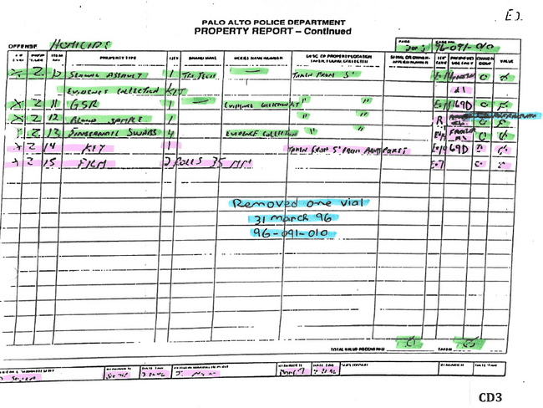
Property evidence reports shows 1 vial in inventory, yet 1 vial removed by Det. Michael Yore on 3-31-96 while one was taken by Officer L. Dillard on 4-3-1996 to crime lab.
This supports 2 vials

Slide 10
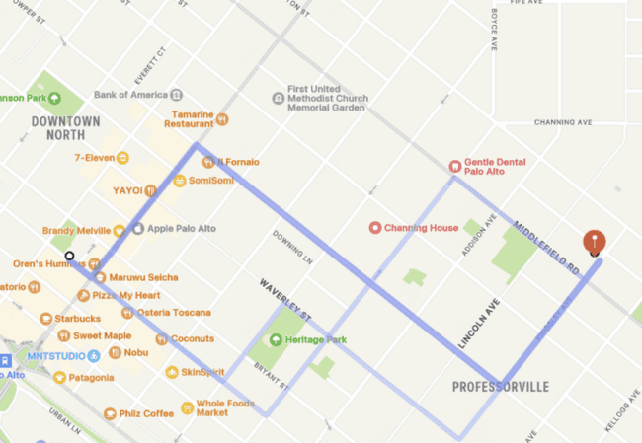
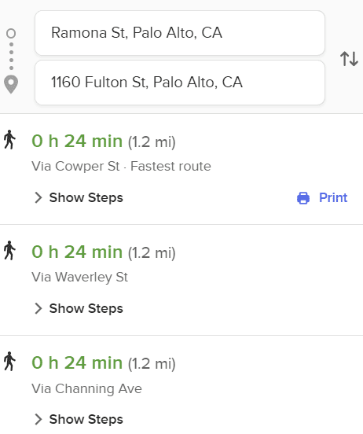
Mr. Wilson’s Timeline of events:
Saturday 3-30-1966
1:05pm arrives at Roger’s Restaurant – Eats
1:30pm finds a woman’s purse – makes a note of it and puts it in backpack
1:35pm leaves Restaurant
1:40pm calls YC from payphone on University Ave asking for pickup at his residence by 2pm and continues home
1:58pm calls YC again to find out that the address was dispatched incorrectly to 116 Fulton Ave.
2:02pm YC arrives starts meter and drives until 3:46pm to CalTrans Station SF
3:50pm Slams hand in door
4:40pm admitted to UCSF Medical Center, SF
10:00pm Discharged from hospital
11:33pm purchases a Cal Trans ticket
Sunday 3-31-1996
12:10am Mr. Wilson takes train to Palo Alto
1:10am arrives
2:50am arrives home
3:45am heads to bathroom and finds Kim – tells Coleman
3:53am Coleman calls police
X
Pay Phone to call Yellow Cab at
1:40pm for pickup at his house at 2:00pm
University Avenue
Crime Scene
1160 Fulton Street
Middlefield Road
X
Roger’s Restaurant @ 1:30pm
Calls Yellow Cab again at 1:58pm

Slide 11
Testimony on behalf of Mr. Wilson:
1. Owner of Roger’s Restaurant – Confirmed Mr. Wilson’s account of a lady that had left her purse.
2. Owner of Yellow Cab – Confirmed that Mr. Wilson called twice that day and the wrong address was dispatched
3. Yellow Cab Driver: Betram Glass– Confirmed he was given wrong address and redirected to Mr. Wilson at 1:58pm and arrived at 2:02pm and picked up Mr. Wilson and meter ran until 3:46pm when he dropped Mr. Wilson off in SF at the CalTrans Station 4th and Townsend.
4. Bertram Glass testifies to event on hand and files incident report, but tells a different story.
5. Medical personnel testify to hand and time in hospital
6. Ms. Kim’s family testified in Mr. Wilson’s defense that Ms. Kim had not dated anyone during that time frame and was not sexually active to their knowledge.
7. The fact that a leaf from the basement floor was stuck to Ms. Kim’s buttocks under her underwear and pants would indicate that her underwear/pants had been removed in the basement and put back on during the course of the events. Coupled with the presence of motile intact sperm, she had been raped either before or after being murdered.
8. Rigor Mortis max 36 hours – Kim’s was done by 9:30am 4-1-996 = she was killed after 9pm Saturday 3-30-1996
9. Subsequent testimony of medical experts shows that only 10-30% of rape victims have visible injury that can be seen by the naked eye under bright light contrary to D.A.’s medical examiner’s testimony.
10. Subsequent testimony of medical experts shows that intact sperm is only motile within 12 hours of being deposited. Then for the next 12 hours the tails begin to separate rendering them no longer motile within 24 hrs. This can take longer if the body is refrigerated. The depositing of the sperm could have happened no earlier than 9:00 pm on Saturday March 30, 1996.

Slide 12
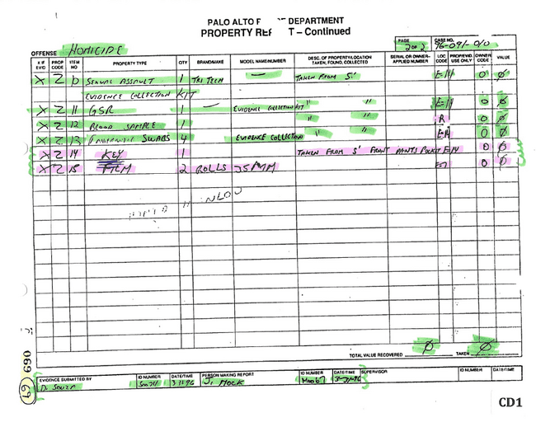
New Evidence
8. 3 property reports showing different writings, obliterations, whiteout, and inconsistent information from the facts listed?!?

Slide 13
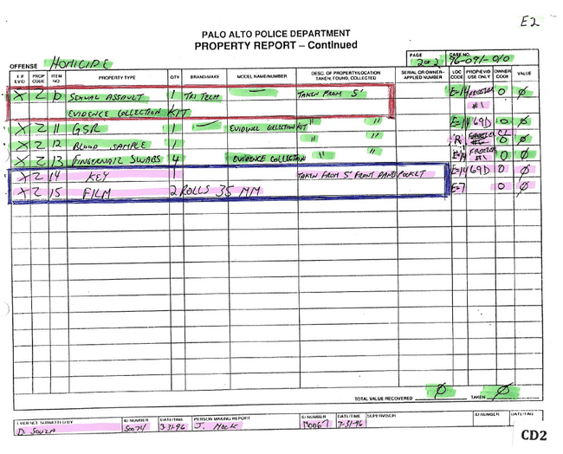

Slide 15
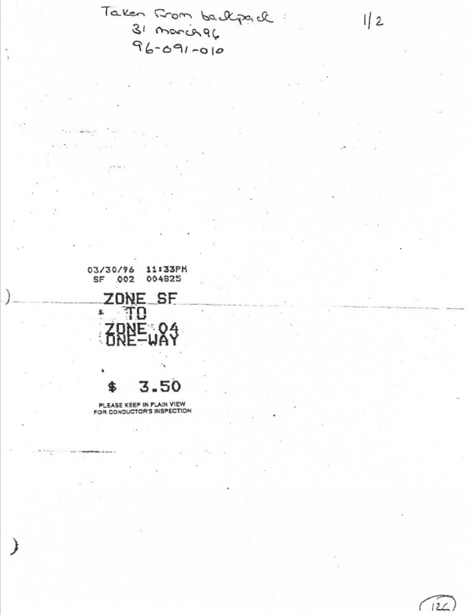
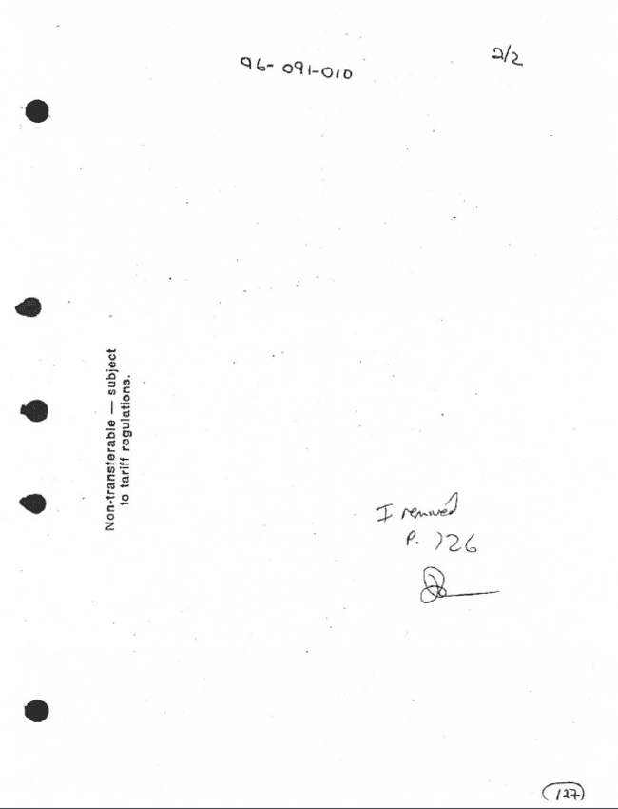
In 2007 Peter Wilson requested copy of police report from PAPD of page 126 because it was missing. Questioned his defense attorney who also said it was missing from his file, so Mr. Wilson requested this page and was given these two pages.
9. Receipt for Cal Trans ticket from San Francisco to Palo Alto at 11:33pm 3-30-1996 also went missing during trial

Slide 16
On 5-10-2019 requests more documents from police file and receives on 3-25-2020.
Another document taken from backpack before warrant was issued was removed from the file and availability of the defense.
10. The alibi note he claimed that was in his backpack, but was conveniently missing at trial is found.

Slide 17
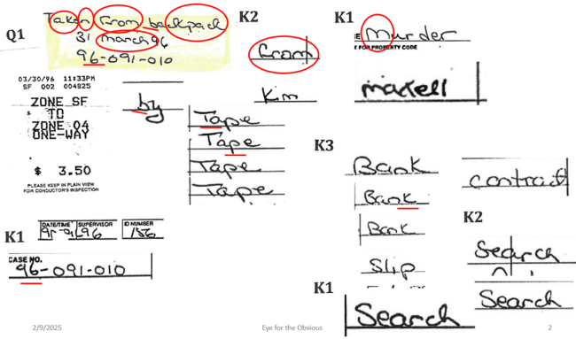

Slide 18
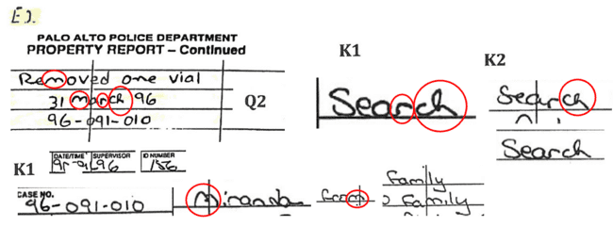
11. Michael Yore did in fact sign out one vial of blood on 3-31-96, and logged the Cal Trans receipt and the handwritten note from the restaurant as being from Mr. Wilson’s backpack on 3-31-96.

Slide 19
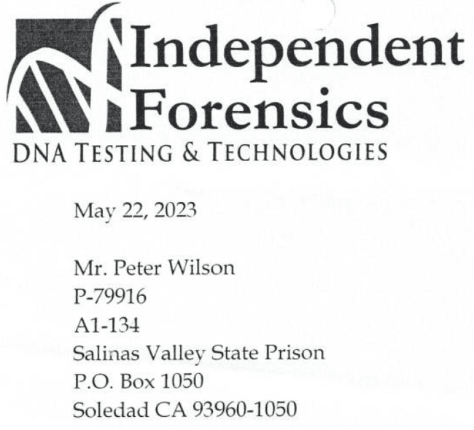
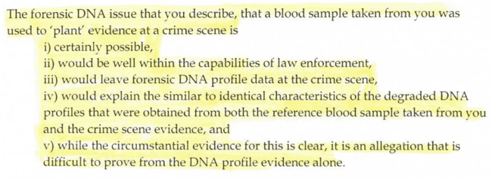
12. DNA lab states that the degradation levels of Mr. Wilson’s DNA is similar to identical from the crime scene and the reference sample taken by the PAPD?!?

Slide 20
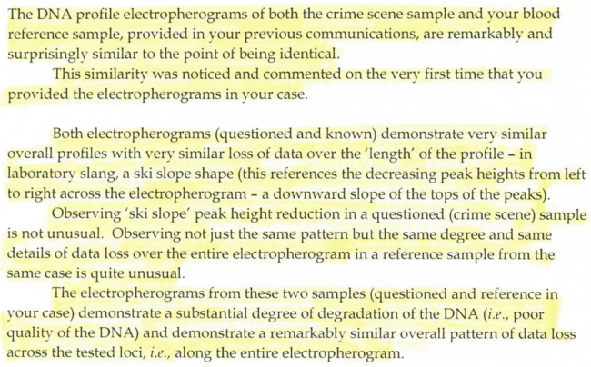

Slide 22
Mr. Wilson’s Evidence for a Writ of Habeas Corpus – Summary:
1. Mr. Wilson contends that he is innocent, and that William Coleman raped/killed Ms. Kim up to 4-5hrs before her body was found at 3:53am on 3-31-1996, and then left the country before his preliminary hearing in July 1996 to never be seen or heard from again, and the DA stipulates to being unable to locate William Coleman in the preliminary hearing. No other suspect was investigated for this crime.
2. Mr. Wilson shows that he was not at home during the time that the DA says he committed the crime.
3. Mr. Wilson shows that pages 9 and 126 were exculpable evidence in his backpack that was illegally searched, seized, copies made and placed into the police file by Officer Micahel Yore.
4. Mr. Wilson contends Officer Yore broke into the evidence room and removed them and $400 from his backpack.
5. Mr. Wilson shows that 2 vials of blood were taken by the Lab Tech at Palo Alto PD.
6. Mr. Wilson shows that Officer Michael Yore removed one vial of blood on 3-31-96.
7. Mr. Wilson shows that Officer L. Dillard took one vial of blood to the lab on 4-3-96.
8. Mr. Wilson shows that 2 Officers claim there was only one vial of blood taken.
9. Mr. Wilson shows that his blood at the crime scene came from the same source as the blood taken by the Lab Tech at the Police Department.
10. Mr. Wilson shows that pages 9 and 126 were purposefully removed from the original police file by the State.
11. Mr. Wilson forensics shows that rigor mortis and motile sperm supports that Kim’s death had to have occurred after 9pm on Saturday 3-30-1996 while he was gone.
12. Mr. Wilson shows that the State’s experts lied in regards to the forensics and subsequently testified in the adverse in future trials.
13. Mr. Wilson shows that the DA led the jury to believe that Kim had not been raped, and the sperm was never tested which could have also excluded Mr. Wilson as a suspect.
14. Mr. Wilson also proves that upon his arrival home, he could not have committed the crime due to the injury he suffered to his hand the day before.

Slide 23
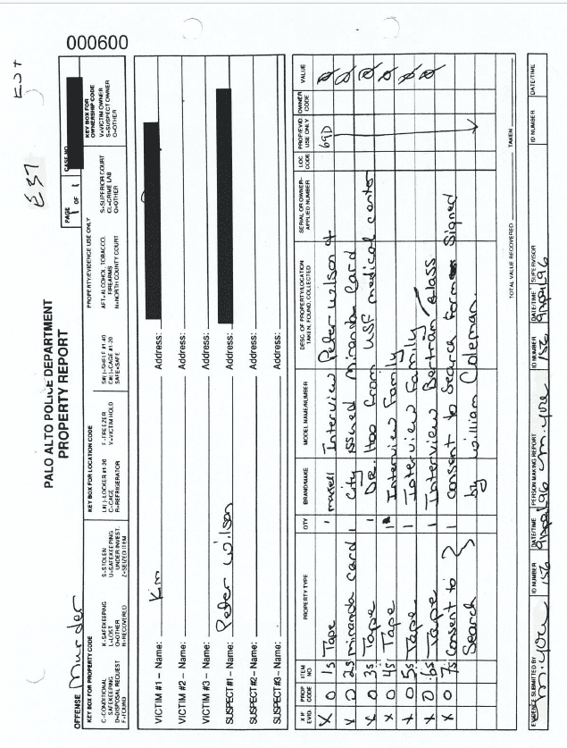
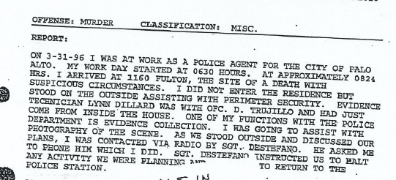

Slide 24
5-9-25: Intro – play final minutes of Peter Wilson 21 mins. Questions and answers…
Mr. Wilson finds Ms. Kim
Coleman’s response to Mr. Wilson finding Ms. Kim
What did Mr. Coleman say on the 911 call? Transcript of 911 call
What County did this occur? Santa Clara County tried in San Jose, CA
What was the race and age of the renters = Peter Wilson and William Coleman?
What is William Coleman’s background?
Did they take the same forensic evidence from William Coleman?
Is there an evidence log on William Coleman? I see that he signed a consent form to search in the property report on the case against Peter Wilson. What was that consent to search?
Who was your lawyer? Mr. or Mrs. Paraskou
Where is Mr. Peter incarcerated? California Health Care Facility, Stockton, CA
When did Mr. Wilson file for the Writ of Habeas Corpus? July 17, 2024

Slide 25
5-2-25 Intro: Break from Zodiac - Covering the Case of a Writ of Habeas Corpus Based on New Evidence for Peter Wilson
http://www.handwritingdocumentexamination.com/pages/free-peter-wilson
https://www.youtube.com/watch?v=fudD04E_9ys = San Joaquin Valley Transparency – Wrongful Conviction
https://youtube.com/@sanjoaquinvalleytransparency1?si=_JC7VIAhzYZj9Rwf
In this 2-part series I will share a previously recorded podcast on the YouTube channel San Joaquin Valley Transparency hosted and produced by David Villa
Today we will play approximately 47 mins of that podcast
Outro: Next Friday I will share the rest of the podcast with time to answer the questions posed during the recording with Nolan Del Campo

Slide 26
5-9-25: Intro – play final minutes of Peter Wilson 21 mins. Questions and answers…
Mr. Wilson finds Ms. Kim
Coleman’s response to Mr. Wilson finding Ms. Kim
What did Mr. Coleman say on the 911 call? Transcript of 911 call
What County did this occur? Santa Clara County tried in San Jose, CA
What was the race and age of the renters = Peter Wilson and William Coleman?
What is William Coleman’s background? = waiting on a response
Did they take the same forensic evidence from William Coleman? = waiting on a response
Is there an evidence log on William Coleman? I see that he signed a consent form to search in the property report on the case against Peter Wilson. What was that consent to search?
Who was your lawyer? Mr. or Mrs. Paraskou = waiting for full name
Where is Mr. Peter incarcerated? California Health Care Facility, Stockton, CA – transferred from Peter Wilson, P-79916, Salinas Valley State Prison, Soledad, CA
When did Mr. Wilson file for the Writ of Habeas Corpus? July 17, 2024

Slide 27

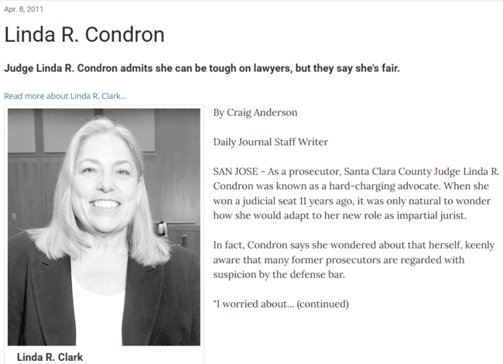
Laundry and Research:

Slide 28
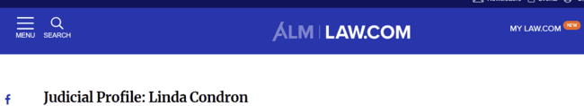
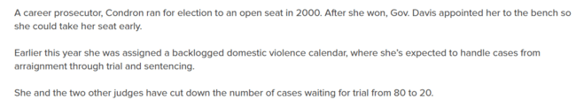
Laundry and Research:

Slide 29
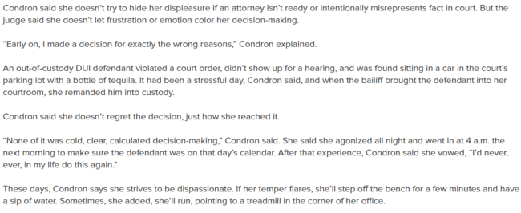
Laundry and Research:

Slide 30

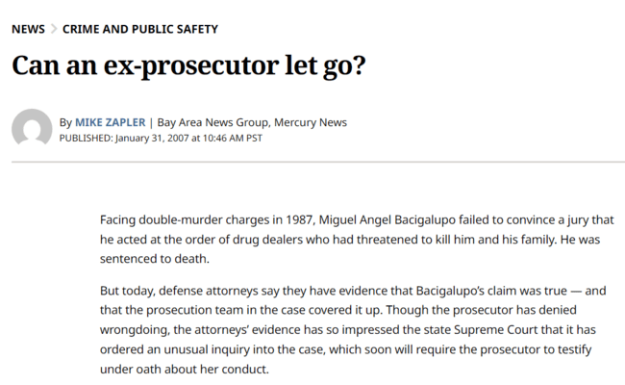
Laundry and Research:
https://www.mercurynews.com/2007/01/31/can-an-ex-prosecutor-let-go/

Slide 31
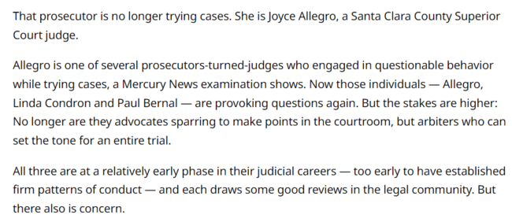
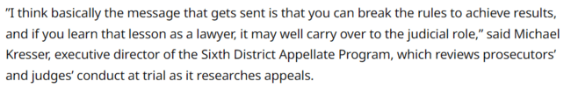
Laundry and Research:

Slide 32
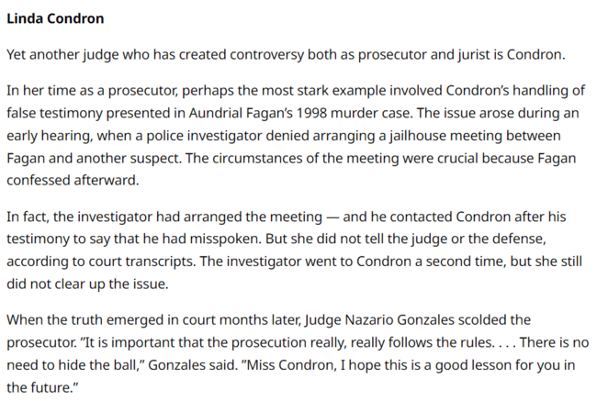
Laundry and Research:

Slide 33
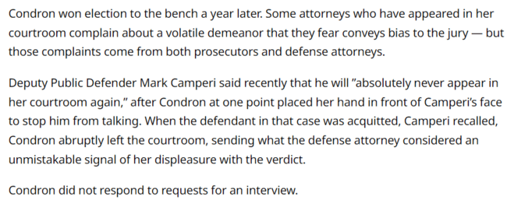
Laundry and Research:

Slide 34
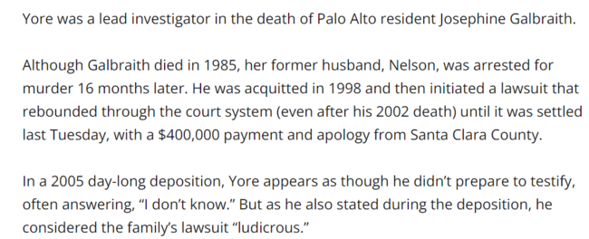
Sgt. Michael Yore:

Slide 35
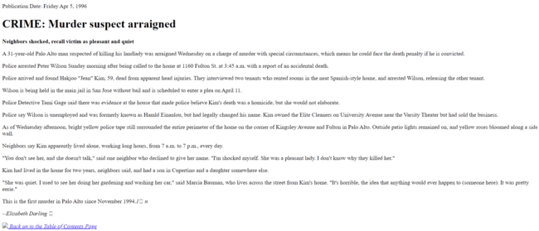
Laundry and Research: Arrested immediately while roommate is released… Arraigned 4-3-1996?!?
Peter Wilson – 31 years old
1996
https://www.paloaltoonline.com/morgue/news/1996_Apr_5.MURDER.html

Slide 36
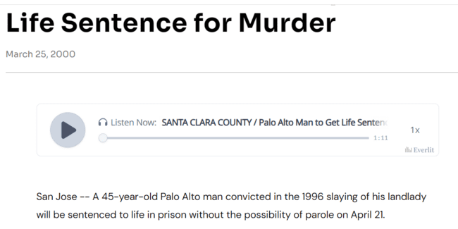
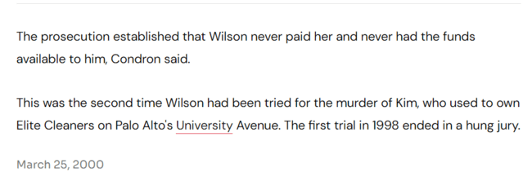
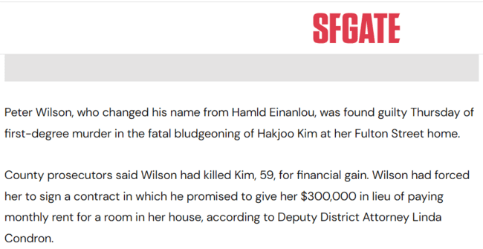
Laundry and Research:
https://www.sfgate.com/bayarea/article/SANTA-CLARA-COUNTY-Palo-Alto-Man-to-Get-Life-2767269.php
Peter Wilson – 45 years
2000

Slide 37
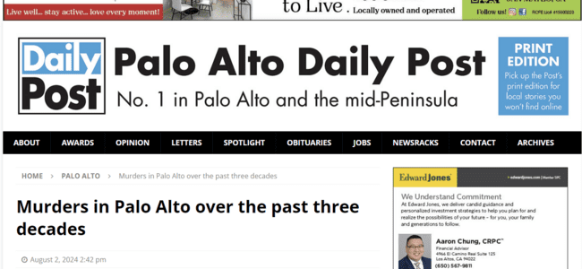
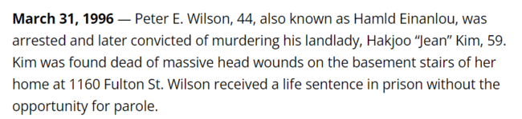
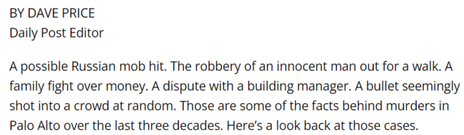
Laundry and Research:
Peter Wilson – 44 years
2024

